Slide 1
Overview of Individual Insurance
Broker Training
10152021

Slide 2
Module Description
This module is designed to explain:
Individual insurance
Sales and Service Area
Eligibility
Enrollment periods
Premium determinations
Plan exclusions
HMO Plans
Important terminology

Slide 3
General Subscriber Eligibility
Subscriber Eligibility:
Must not be eligible for Medicare or Medicaid
Must continually and permanently reside in the plan’s service area. If having two places of residency, the address location for which the Federal Income Tax is filed is considered the place of residency.
Must submit a completed and signed application through the online enrollment platform
Must satisfy the required premiums

Slide 4
General Dependent Eligibility
Spouse:
Must be a lawful spouse
Must not be eligible for Medicare or Medicaid at the time of application
Not entitled to benefits under Title XVIII of the Social Security Act
Dependent Child:
Any child who is one of the following:
Natural-born child
Stepchild
Child through legal guardianship
Foster child
Legally adopted child
ON and OFF Marketplace
Children are covered through the end of the calendar year in which they reach age 26 without restrictions. If older than 26 and stilled claimed by a parent as a dependent, the child can enroll on the same Marketplace application, however, they would have to enroll on their own separate plan by ungrouping through the Healthcare Marketplace.
OFF Marketplace Only
Coverage can be extended through the end of the calendar year in which the child reaches age 30 if the child:
is a state resident or full-time or part-time student, AND
they do not have other health insurance coverage, AND
is unmarried without dependents of their own
Dependent children are not entitled to benefits under Title XVIII of the Social Security Act

Slide 5
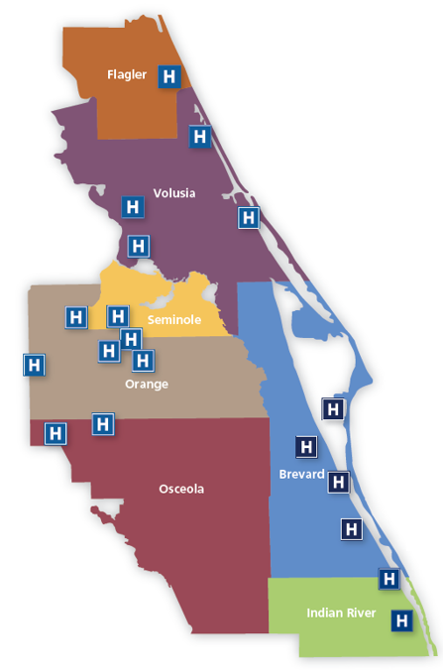
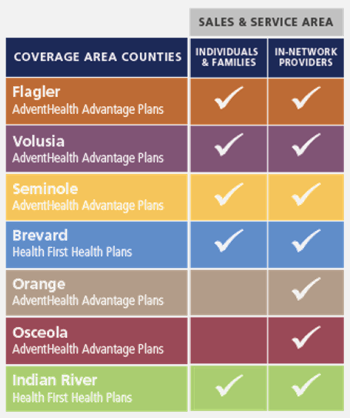
Individual Plans – Service Area

Slide 6
Enrollment Periods
Open Enrollment Period (OEP)
November 1 to January 15
Individuals must enroll during this time period unless eligible for an SEP.
To complete the enrollment process, the applicant must complete and electronically sign the Enrollment Application and submit the first month’s premium payment by mail, by phone or online.
All health plans in the Individual market are Guaranteed Issue (a policy is offered to any eligible applicant without regard to health status).
Special Enrollment Period (SEP)
Individuals can apply for coverage on an individual plan during this time with a qualifying life event.
Proper documentation of the SEP must be provided within 30 days of the initial application.

Slide 7
Special Enrollment Period
Certain events allow eligible individuals to enroll during a Special Enrollment Period:
Loss of minimum essential coverage (non-payment does not qualify)
Marriage, birth or placement for adoption
Gain of citizenship or qualifying immigration status
Gain status in a Native American tribe
Moving inside or outside of coverage area (you must prove that you had qualifying health coverage at least 1 day within the last 60 days)
Enrollment errors related to Exchange/Marketplace
Change in eligibility for tax credits or cost sharing reductions for On Marketplace Plans
Exceptional circumstances – Only Marketplace can grant
Incarceration release
If eligible for a Tax Credit due to income change and currently enrolled on an Off Marketplace plan.
There is a 60-day deadline to enroll in coverage for most of these events.
If you missed the Open Enrollment deadline of January 15, you must have one of the above reasons to enroll in health insurance coverage.

Slide 8
Individual & Family Premiums
Individual Premium:
Members pay a set premium, due on the 1st of each month.
Note: Members in a conditional status would need to pay their first premium to activate coverage.
Premiums are determined by five criteria:
Plan type selected
Age
Tobacco use
Geographic location (ZIP code)
Amount of Tax Credits applied (for On Marketplace Members)

Slide 9
Individual & Family Premiums
Advanced Premium Tax Credits (APTC)
Members may qualify for assistance through the Marketplace.
If the member qualifies, they will receive an Advanced Premium Tax Credit (APTC), also known as a subsidy.
An APTC can reduce what a beneficiary pays for insurance.
When a member applies for coverage in the Health Insurance Marketplace, they will estimate their expected income. If estimated income falls within a specific range, the applicant may choose to use an APTC to lower their monthly premium.

Slide 10
Plan Exclusions
Procedures deemed not medically necessary are not covered.
Exclusions and limitations are interpreted by the plans and listed in the subscriber’s contract.
Common examples:
Alternative medicine treatments
Acupuncture
Bariatric services
Complications of non-covered services
Cosmetic surgery
Custodial care
Infertility services

Slide 11
HFHP High Value Network Plans
Offer the same comprehensive benefits at a lower monthly premium
Lower Deductibles and Copayments when using the HVN
Separate Calendar Year deductibles for HVN and INN
Combined Maximum Out of Pocket Expense
Member/Family will never exceed OOP max
No referrals or extra prior authorization
Reduced waste in drug utilization by identifying evidence-based clinical opportunities that drive prescription savings for members.

Slide 12
AHAP Value RX Plans
Offer the same comprehensive benefits at a lower monthly premium
Members have access to the Drug Savings Review Program, regardless of which in-network pharmacy they choose.
The program helps reduce waste in drug utilization by identifying evidence-based clinical opportunities that can drive prescription savings for members.
Program works directly with the member’s doctor to provide timely, actionable, plan member specific interventions and only is only offered to HVN members.

Slide 13
Important Terminology
Term | Definition
Balance Billing | When a provider bills a member for an amount greater than their cost share for a covered service Not allowed with in-network providers Out-of-network providers are permitted to balance bill
Certificate of Credible Coverage (COCC) | Attestation of coverage Only available upon request
Evidence of Coverage (EOC) | Contract between a Commercial member and the insurance company.
High Value Network Plans | Cost effective plan option – lower premium and lower copays when using selected network of providers and facilities

Slide 14
Important Terminology
Term | Definition
In-Network (INN) Cost Share | The amount a member will pay for a covered service received by a provider that participates with Health First Health Plans.
Schedule of Benefits | Document used by a member, in conjunction with their contract, to clarify cost share and benefit limitations of covered medical services. Considered part of the contract.
Stackable Benefits | Administrative guideline that assesses separate cost shares when multiple outpatient services are received by a member. Does not apply for inpatient services.

Slide 15
Important Terminology
Term | Definition
Summary of Benefits and Coverage (SBC) | Describes plan benefits and coverage in a standardized format required for all ACA plans.
Summary Plan Description (SPD) | Contract between an ASO/TPA group and the insurance company.

Slide 16
Thank You!

